Slide 1
MODULE 5
Fuzzy Sets – Concept of a Fuzzy number – Operations on Fuzzy sets – Typical Membership functions – Discrete Fuzzy Sets.
T.Bk : Introduction to Fuzzy Logic using Matlab by S. N. Sivanandam, S. Sumathi and S. N. Deepa.
Expert system – Representing and using domain knowledge – Reasoning with knowledge – Expert System Shells – Support for explanation – examples – Knowledge acquisition examples.

Slide 2
Fuzzy Logic
Branch of logic designed for representing knowledge.
Traditional logic does not include degrees of imprecision.
Fuzziness refers to uncertainty associated with a system.
All real life situations have some degree of uncertainty or fuzziness.
A fuzzy number is a quantity whose value is imprecise rather than exact as in the case with ordinary numbers.
Variables or functions associated with imprecise or uncertain phenomenon are known as fuzzy variables or fuzzy functions.

Slide 3
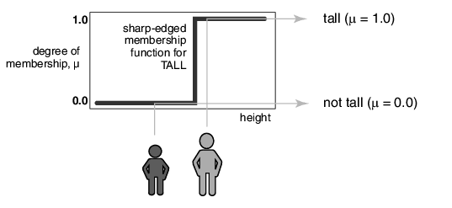
Consider the set of tall men. People taller than or equal to 6 feet are tall. This set can be represented graphically as follows:

Slide 4
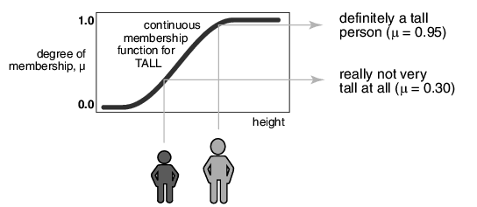

Slide 5

Difference between Fuzzy and Crisp Sets
A fuzzy set is a set containing elements that have varying degrees of membership in the set.
In classical or crisp set, elements would not be members unless their membership was full or complete in that set. In fuzzy set, membership of elements need not be complete.
  - In crisp sets, characteristic fn or membership fn is given by

Slide 6

  - Whereas in fuzzy sets, Membership function is a function in [0,1] that represents the degree of belonging.
  The larger the number in [0,1], the more the degree of belonging.
A classical set or crisp set has a unique membership function whereas a fuzzy set can have an infinite number of membership functions to represent it.
  i.e in fuzzy sets, a number between 0 and 1 indicates the degree of membership to a set.

Slide 7
Formal Definition of a Fuzzy Set
For any fuzzy set, (let’s say) A, the function µ_{A} represents the membership function for which µ_{A}(x) indicates the degree of membership that x, of the universal set X, belongs to set A and is, usually, expressed as a number between 0 and 1.
µ_{A}(x) : X [0,1]
The translation from x to µA(x) is known as fuzzification
Fuzzy sets can be either discrete or continuous.
The notation for fuzzy sets: for the member, x, of a discrete set with membership µ, we use the notation µ/x . In other words, x is a member of the set to degree µ.

Slide 8


A Discrete set, A is defined as:
A = µ₁ /x₁+µ₂/x₂+…..+µ_{n}/x_{n}
or (in a more compact form)
Where, x₁ ,x₂ , ….. x_{n} : members of the set A
µ₁, µ₂,…..µ_{n} are x₁ , x₂ ….. x_{n} ’s degree of membership.
A continuous fuzzy set, A can be defined as:

Slide 9
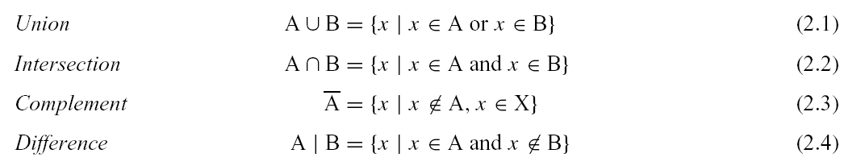
Operations on Classical Sets

Slide 10

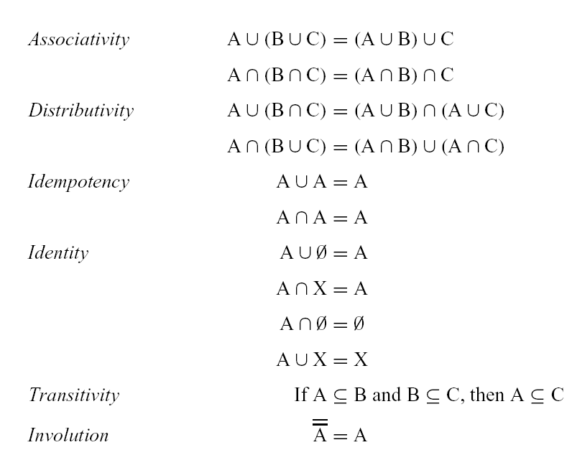
Properties of Classical (Crisp) Sets

Slide 11
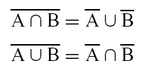
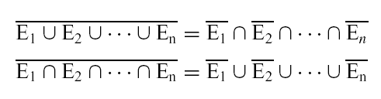
De Morgan’s Principles

Slide 12
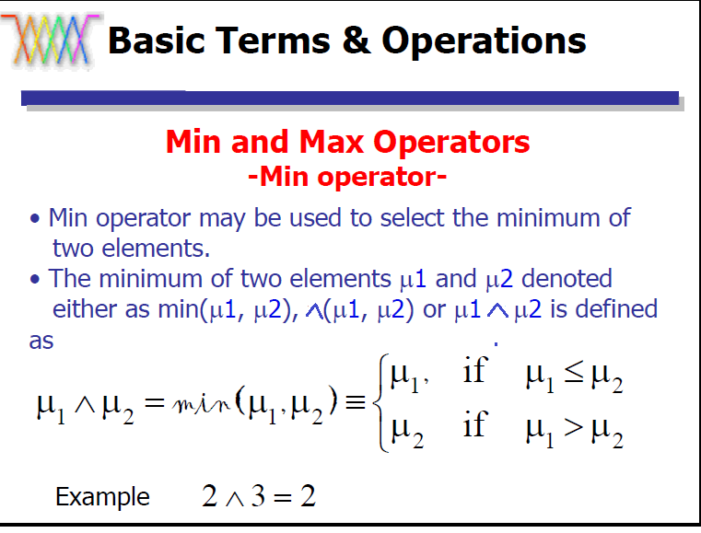


Slide 13
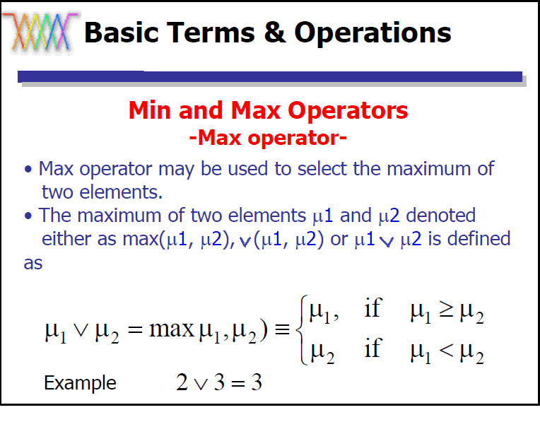

Slide 14
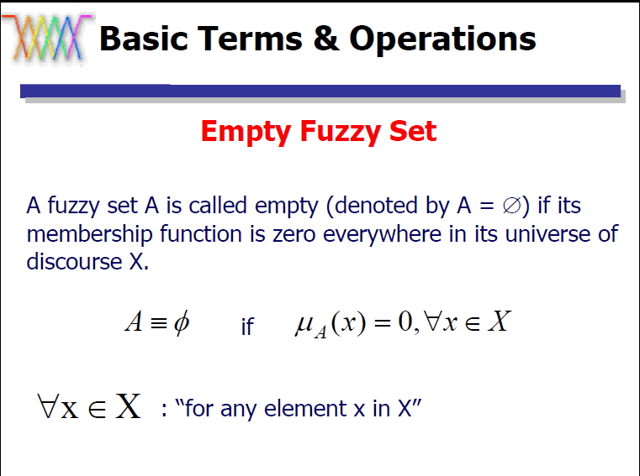

Slide 15
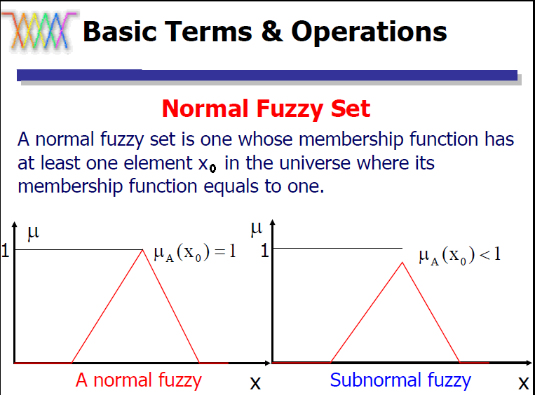

Slide 16
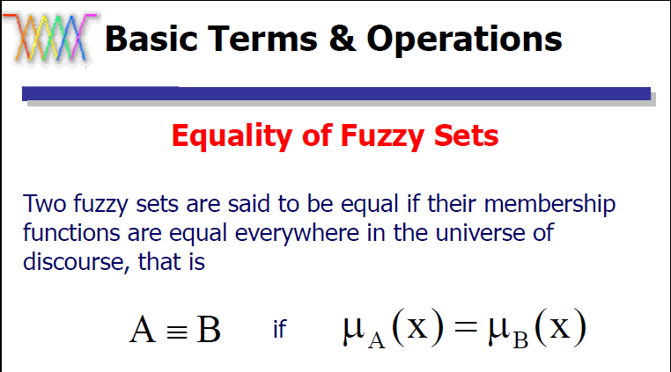

Slide 17
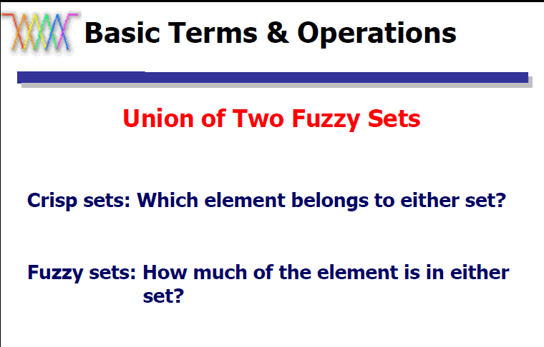

Slide 18
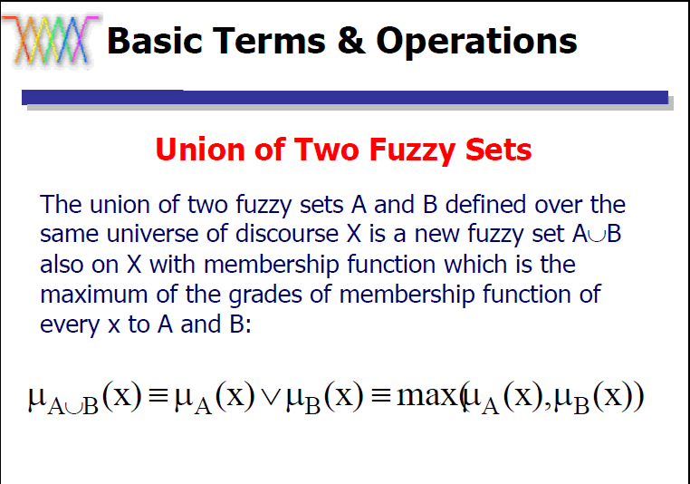

Slide 19
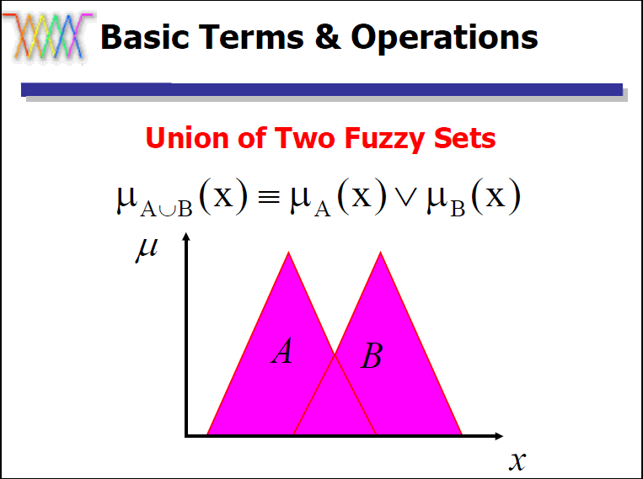

Slide 20
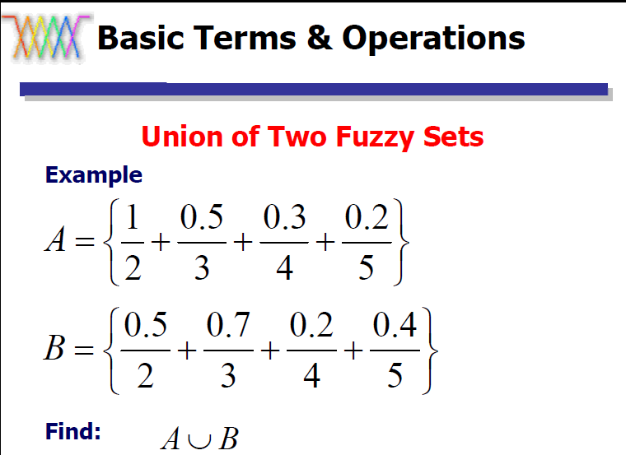

Slide 21
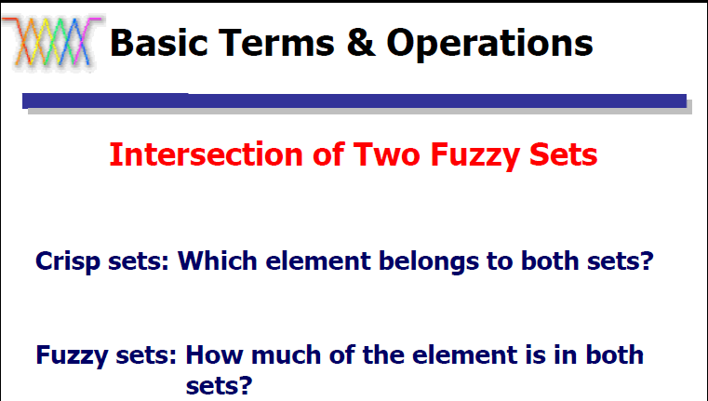

Slide 22
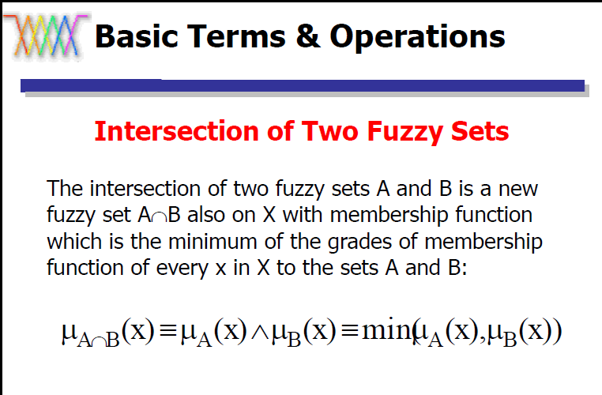

Slide 23
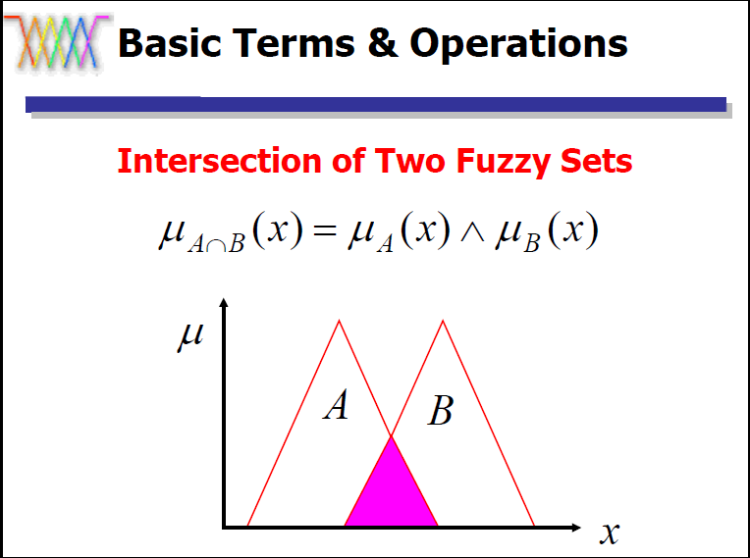

Slide 24
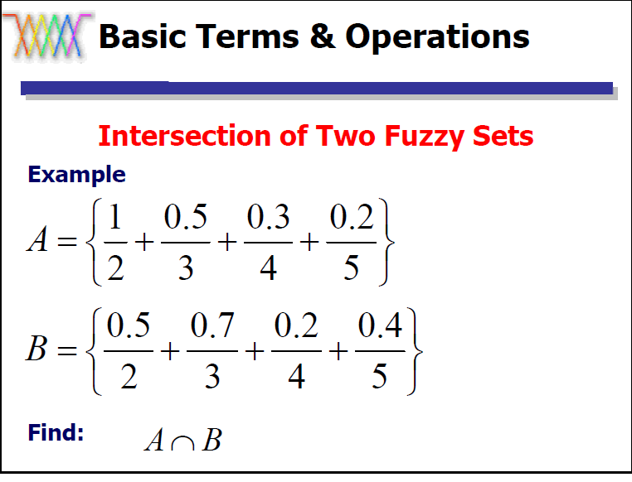

Slide 25
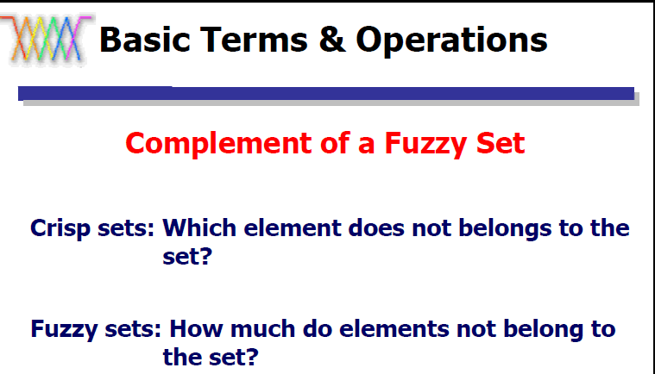

Slide 26
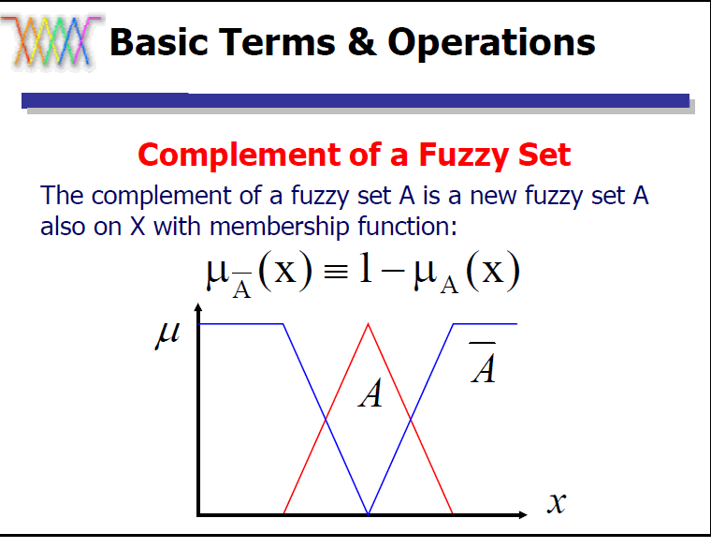

Slide 27
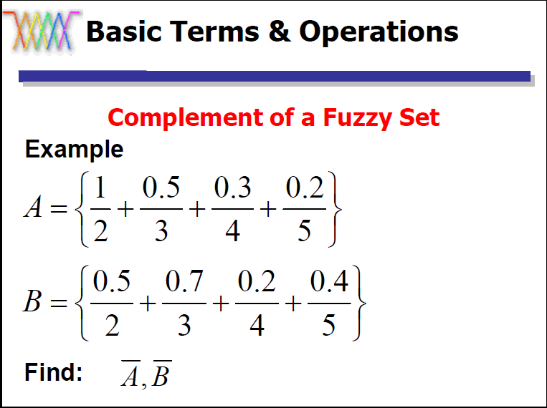

Slide 28
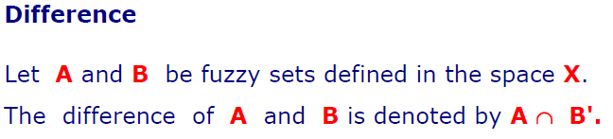

Slide 29
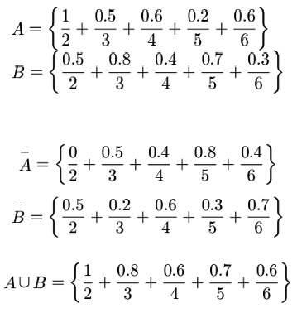

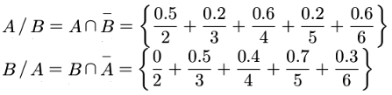

Slide 30
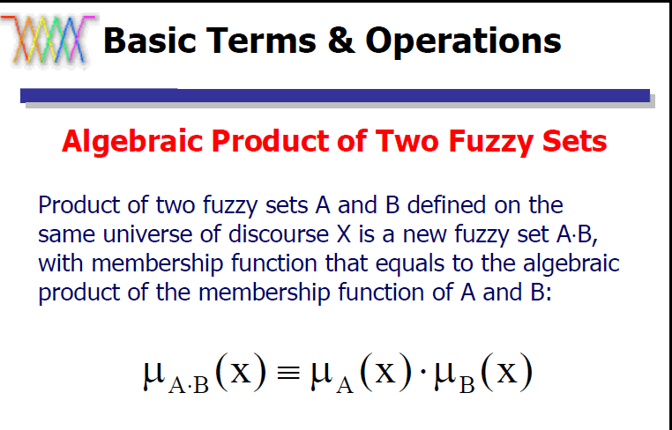

Slide 31
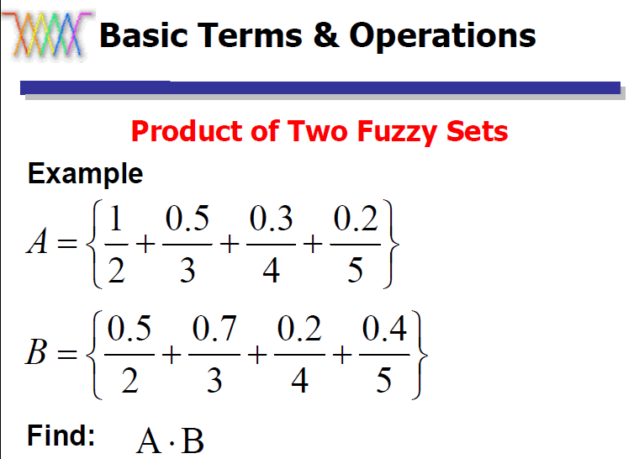

Slide 32
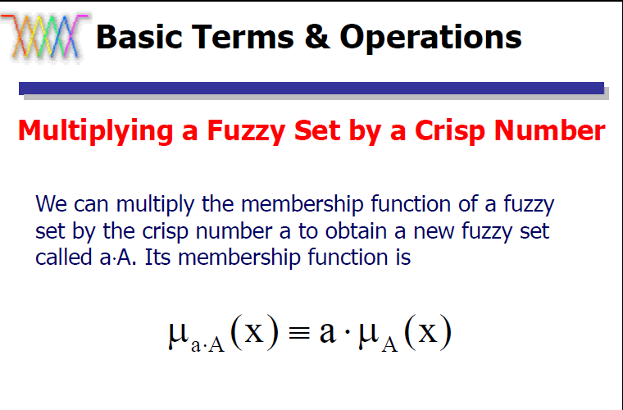

Slide 33
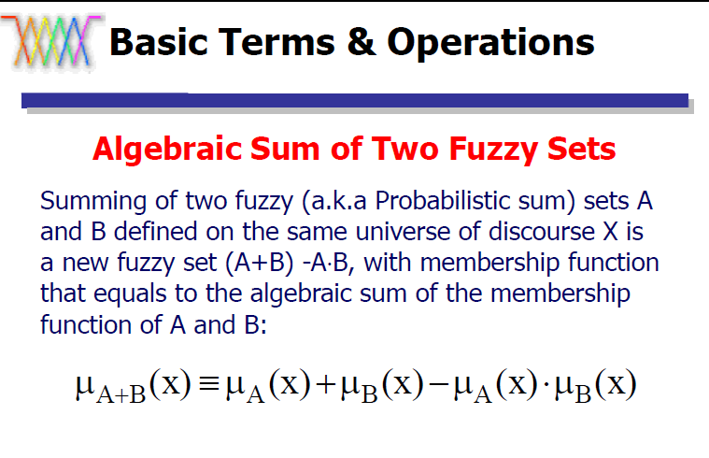

Slide 34
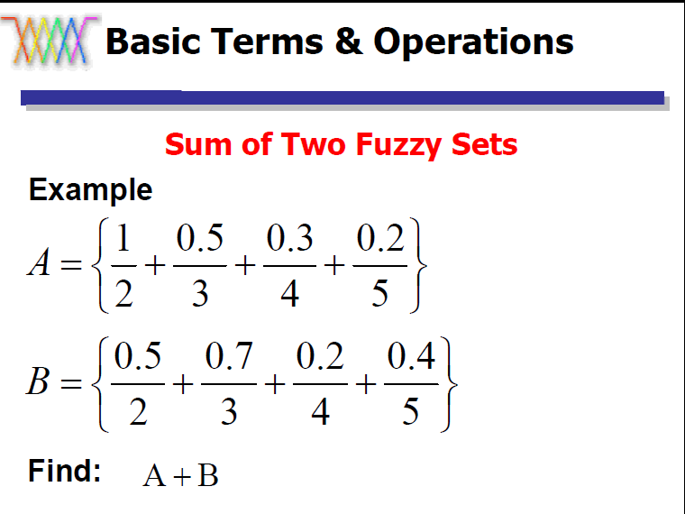

Slide 35
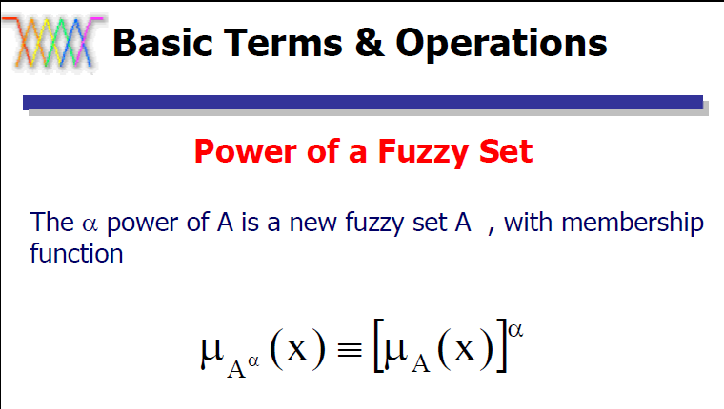

Slide 36
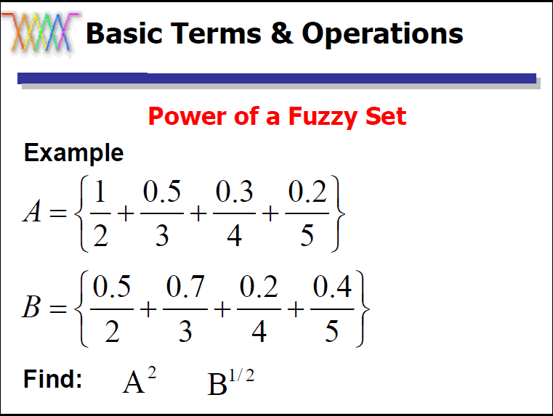

Slide 37
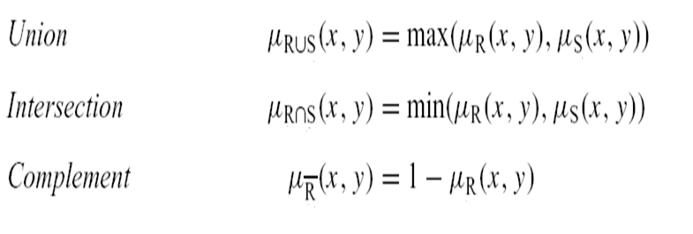

Slide 38
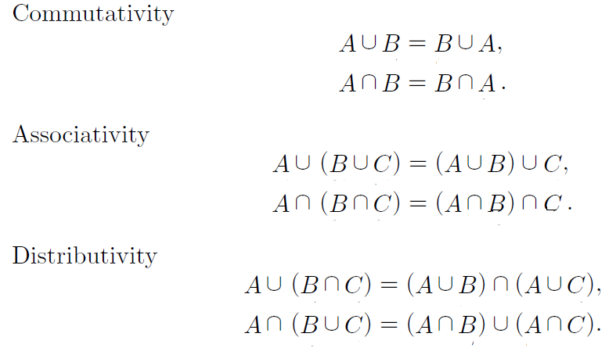
Properties on Fuzzy sets

Slide 39
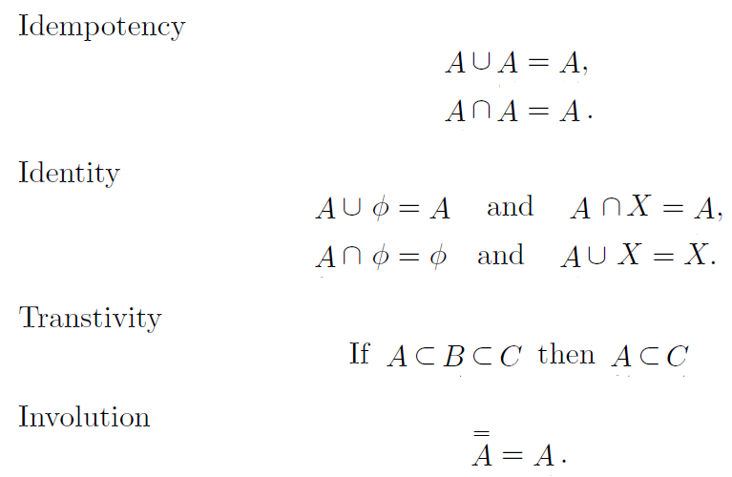

Slide 40
Fuzzy Membership Function
A membership function for a fuzzy set A on the universe of discourse X is defined as µ_{A}:X → [0,1], where each element of X is mapped to a value between 0 and 1. This value, called membership value or degree of membership, quantifies the grade of membership of the element in X to the fuzzy set A.
It is used to graphically represent a fuzzy set. The x axis represents the universe of discourse, whereas the y axis represents the degrees of membership in the [0,1] interval.

Slide 41
Features of Membership Function
The feature of the membership function is defined by three properties. They are
  Core
  Support
  Boundary

Slide 42
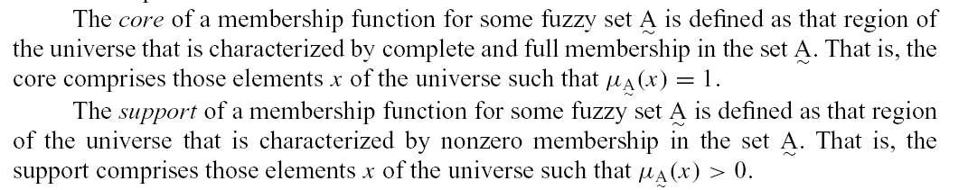
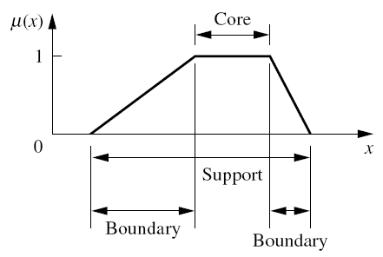

Slide 43
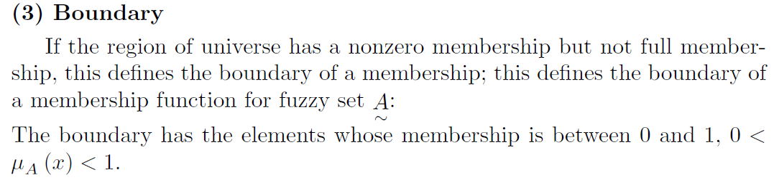

Slide 44
Classification of Fuzzy Sets
The fuzzy sets can be classified based on the membership functions. They are:
Normal fuzzy set: If the membership function has at least one element in the universe whose value is equal to 1, then that set is called as normal fuzzy set.
Subnormal fuzzy set: If the membership function has the membership values less than 1, then that set is called as subnormal fuzzy set.

Slide 45
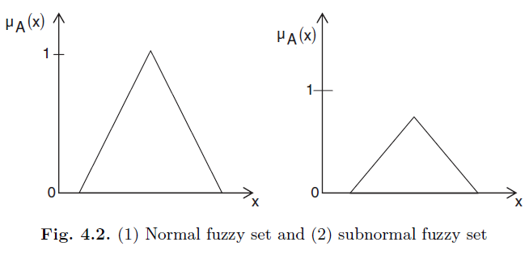

Slide 46
Convex fuzzy set: If the membership function has membership values those are monotonically increasing, or, monotonically decreasing with increasing values for elements in the universe, then those fuzzy set A is called convex fuzzy set.
Nonconvex fuzzy set: If the membership function has membership values which are not strictly monotonically increasing or monotonically decreasing with increasing values for elements in the universe, then this is called as nonconvex fuzzy set.

Slide 47
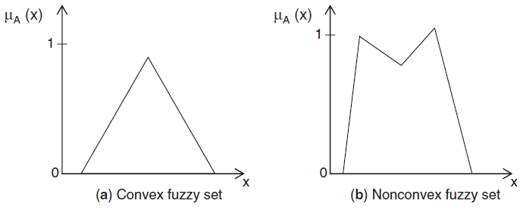

Slide 48
Typical Membership Functions
Simple functions are used to build membership functions.
Examples:
  Triangular Function
  Trapezoidal function
  Gaussian function

Slide 49
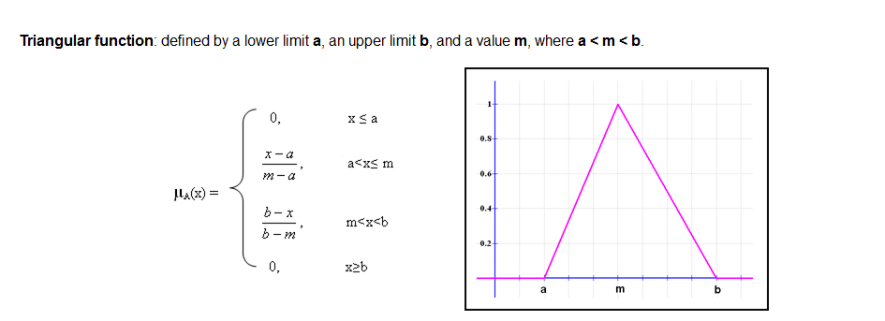
Triangular Function

Slide 50
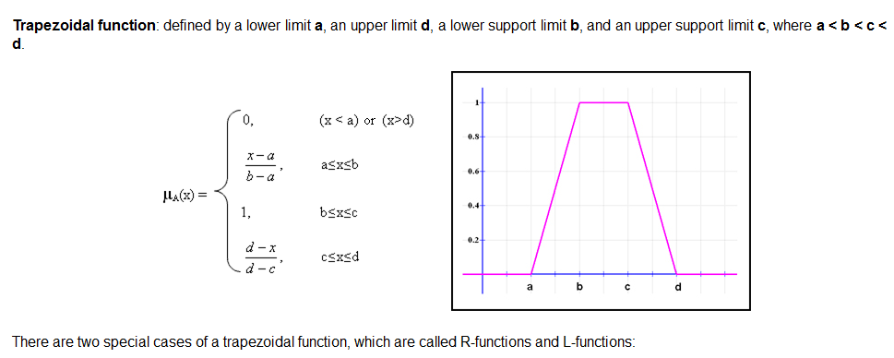
Trapezoidal function

Slide 51
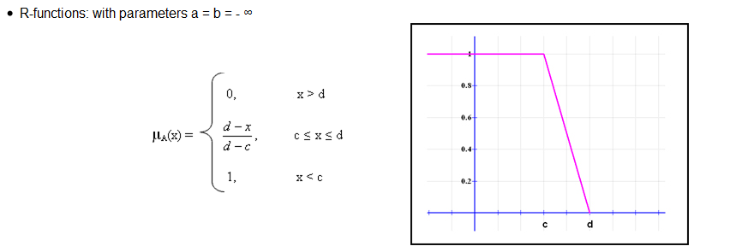
R-Functions

Slide 52
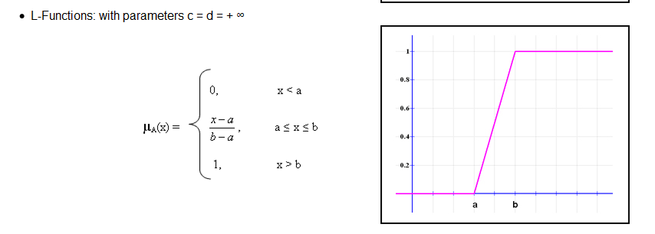
L-Functions

Slide 53
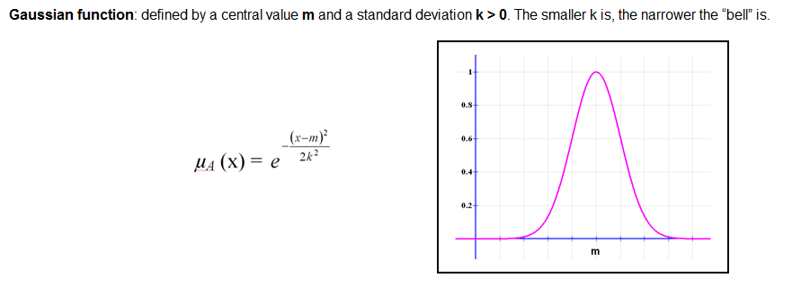
Gaussian function

Slide 54
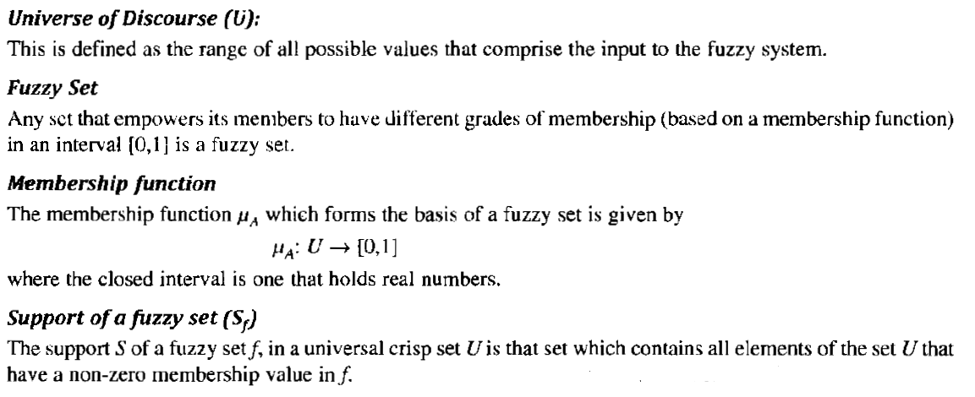
Some Fuzzy Terminologies

Slide 55
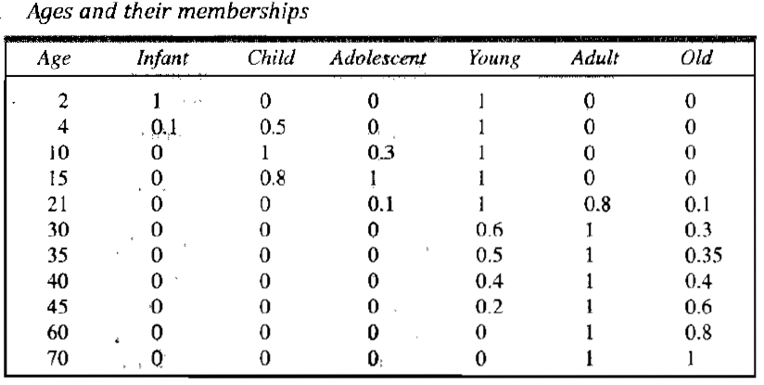
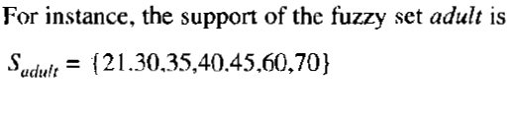

Slide 56
EXPERT SYSTEMS
Solve problems normally solved by human experts.
Modeling computers to do specific tasks in the same way human experts do.
Highly domain specific.
Eg. Expert Systems built for diagnosis of diseases will only do that task.

Slide 57
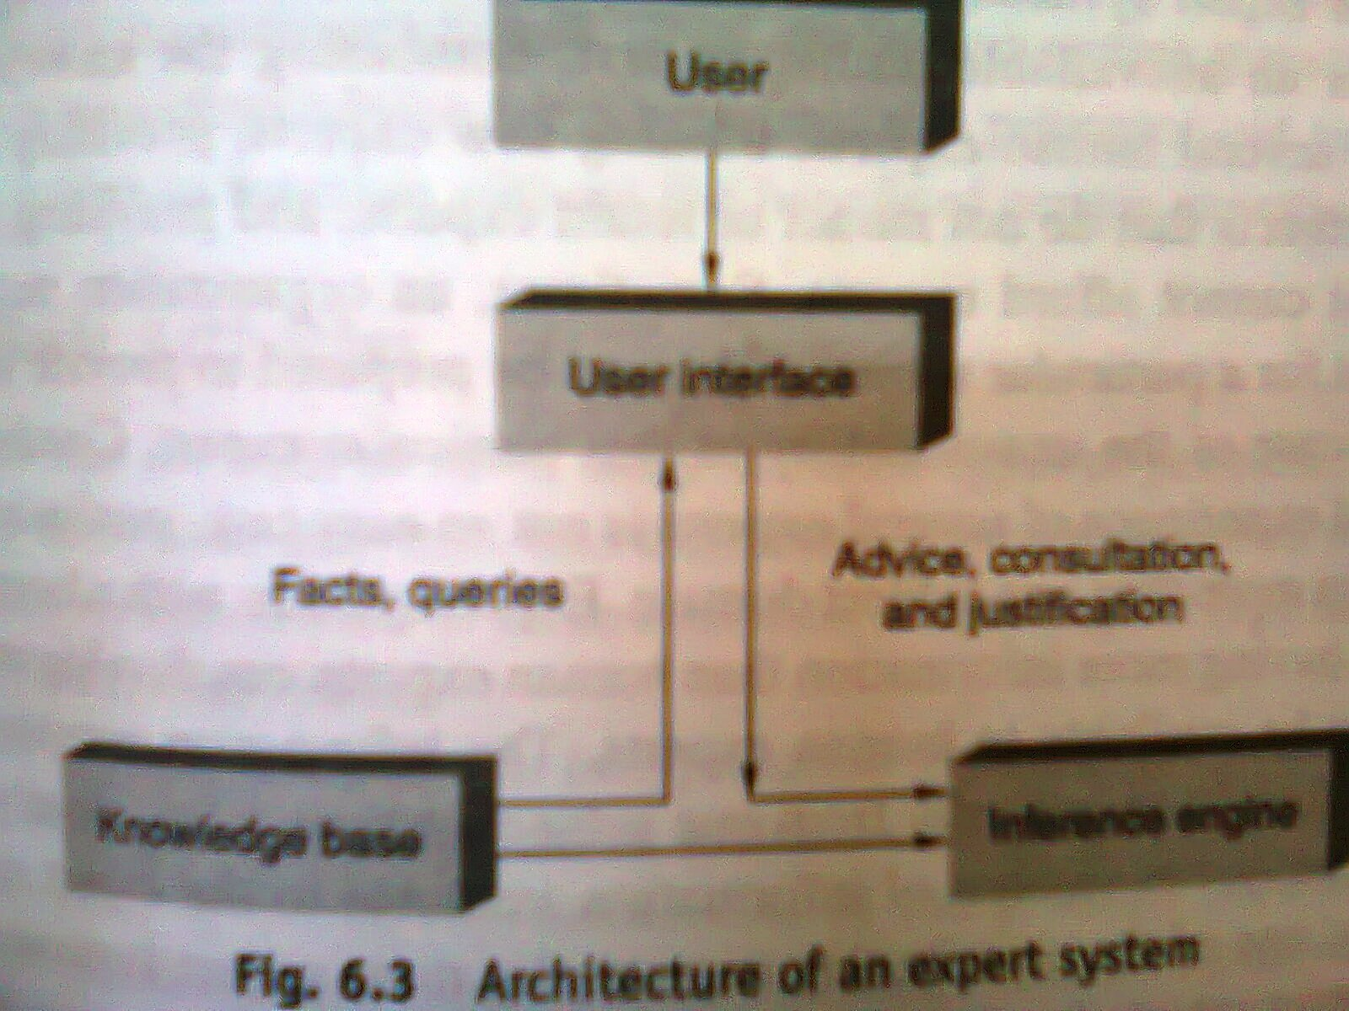
Architecture of expert system

Slide 58
User interface
  Allows user to enter rules and facts about a particular situation and ask questions to the system.
  Provide responses to user requests.
  Supports all other communication between system and user.
Knowledge base
  Developed by experts in the area.
  Data in the form of rules.
  Is updated regularly so that system provides most relevant and complete assistance to the user – knowledge acquisition module.
Inference Engine
  Uses rules provided by Knowledge base and the user to infer new facts.

Slide 59
Representing and Using Domain Knowledge
Most widely used way for representing knowledge : Set of production rules of the form if-then.
MYCIN is an example for expert system, since it performs a task normally done by human experts.
MYCIN attempts to recommend appropriate therapies for patients with bacterial infections.
MYCIN represents most of its diagnostic knowledge as a set of rules.

Slide 60
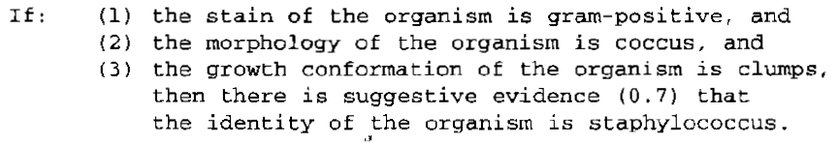
A typical MYCIN rule looks like:
Rule has a certainty factor associated with it, which is a measure of the extent to which the evidence that is described by the antecedent of the rule supports the conclusion that is given in the rule’s consequent.
Certainty factor has a value between 0 and 1.

Slide 61
Rules are written in LISP language.
Once the identity of organism causing disease is revealed, it then attempts to select a therapy by which the disease can be treated.
R1 (also called XCON) is an example for expert system used in the design domain.
Used to select the computer system components based on the customer's requirements.
It is a program that configures VAX systems.

Slide 62

Rules of RI look like:
Unlike MYCIN, there is no measure of certainty in rules of RI
i.e. it is possible to state exactly what it has to do for each situation.

Slide 63

PROSPECTOR is expert system that provides advice on mineral exploration.
Its rule looks like :
Here, each rule contains two confidence estimates.
  The first estimate indicates the extent to which the presence of evidence described in the condition part of rule suggests the validity of rule’s conclusion.
  The second estimate indicates the extent to which the lack of evidence indicates that the conclusion is not valid.
  The no: 2 indicates the presence of evidence is mildly encouraging. And no:-4 indicates the absence of evidence is strongly discouraging for conclusion.

Slide 64

DESIGN ADVISOR is an expert system that critics chip designs.
Its rule looks like :
This system gives advice to chip designer, who can accept or reject the advice.
The system exploits a justification-based truth maintenance.

Slide 65
Reasoning with the Knowledge
Expert System represent knowledge in a rule format. Hence also known as Rule-Based Expert System.
Some reasoning mechanisms: Forward chaining, backward chaining, or some combination of both, is usually used.
For eg: MYCIN uses backward chaining to discover what organisms are present, then it uses forward chaining to reason from organisms a treatment strategy.
R1 system used forward chaining.
Other reasoning mechanisms are also used. Eg : DESIGN ADVISOR system uses justification-based truth maintenance system.

Slide 66
Expert System Shells
The part of an expert system that does not contain any domain specific or case specific knowledge is the expert system shell.
Expert System is usually built from scratch in LISP.
But several systems has a lot of common things.
A single expert system shell can be used to build a number of different expert systems.

Slide 67


Slide 68
Knowledge base: database of rules (domain knowledge).
Explanation system: explains the decisions the system makes.
Knowledge base editor: allows the user to edit the information in the knowledge base.
User Interface: the means by which the user interacts with the expert system.

Slide 69
An example of an expert system shell is EMYCIN.
Shell: A special purpose tool designed for certain types of application in which the user must only supply the knowledge base (EMYCIN).
EMYCIN is a domain-independent version of MYCIN that contains all of MYCIN except its knowledge.
EMYCIN facilitated the development of other expert systems, such as PUFF, an application for the diagnosis of pulmonary problems.

Slide 70
Explanation
In order for an expert system to be an effective tool, people must be able to interact with it easily.
To facilitate this interaction, expert system should have the following two capabilities in addition to its underlying task:
  Explain its reasoning : People will not accept results unless they are convinced of the accuracy of the reasoning process that produced the results.
  eg: In medicine, a doctor must accept ultimate responsibility for a diagnosis, even if the diagnosis was arrived using help from a program.

Slide 71
  b) Acquire new knowledge and modifications of old knowledge: Expert systems derive their power from the richness of the knowledge bases they exploit. Hence it should be complete and accurate.
  - One way to get the knowledge is through interaction with human expert.
  - To have program learn expert behavior from raw data.
TEIRESIAS was the first program to support explanation and knowledge acquisition.
TEIRESIAS served as the front end for the MYCIN expert system.
A fragment of a TEIRESIAS-MYCIN conversation with a user (a doctor) is shown below:

Slide 72


Slide 73
The first question that the user asks is a “why” question, which is assumed to mean “why do you need to know that?” (some tests are expensive or dangerous, so it is important for the doctor to be convinced that the information is really needed before ordering the test). Since MYCIN is reasoning backward, question can be answered by examining goal tree. If the user is not satisfied he can further ask “why”.
After TEIRESIAS tells the user what it believes, the user may want to know the basis for those beliefs. The user can ask this with a “how” question, which TEIRESIAS will interpret as “How did you know that?” The question can also be answered by looking into goal tree and by backward reasoning process.

Slide 74
The production system model is very general. So, it fails to provide all explanations that a human wants. TEIRESIAS-MYCIN just answers questions “why” and “how”.
SALT is a knowledge acquisition program that is capable of answering additional questions like “why-not” and “what-if”

Slide 75
Knowledge Acquisition
There are many programs that interact with domain experts to extract expert knowledge effficiently.
These programs provide support for the foll activities:
  Entering knowledge.
  Maintaining knowledge base consistency.
  Ensuring knowledge base completeness.
There are two ways to get domain knowledge
  One way to get the knowledge is through interaction with human expert.
  To have program learn expert behavior from raw data.

Slide 76
MOLE is a knowledge acquistion system for heuristic classification problems, such as diagnosing diseases.
It uses cover-and-differentiate problem-solving method.
An expert system produced by MOLE accepts input data, comes up with a set of explanations or classifications that cover(or explain) the data, then uses differentiating knowledge to determine which one is the best. The process is iterative.
MOLE interacts with a domain expert to produce a knowledge base that a system called MOLE-p uses to solve problems.

Slide 77
The acquisition proceeds through several steps:
  Initial Knowledge base construction: MOLE asks the expert to list common experts or complaints that might require diagnosis. For each symptom MOLE prompts for a list of possible explanations. It keeps on seeking higher level explanation until comes up with a set of ultimate causes.
  Refinement of the knowledge base: MOLE tries to identify the weakness of the knowledge base. One approach is to find holes and prompt the expert to fill them. It is difficult to know whether a knowledge base is complete, so MOLE lets expert watch MOLE-p solving problems. Whenever MOLE-p makes a wrong diagnosis, the expert adds new knowledge.

Slide 78
One problem solving method useful for design tasks is called propose-and-revise.
Propose-and-revise build up solutions incrementally.
The system first proposes an extension to the current design. Then it checks whether the extension violates any global or local constraints. Constraint violations are fixed and the process repeats.
SALT is a knowledge acquistion program used to build expert systems that design artifacts through a propose-and-revise strategy.

Slide 79
SALT builds a dependancy network as it converses with the expert.
Each node stands for a value of a parameter that must be acquired or generated.
There are three kinds of links: contributes-to, constraints and suggest-revision-of.
Associated with the first type of link are procedures that allow SALT to generate a value for one parameter based on the value of another.

Slide 80
The second type of link is used to rule out certain parameter values.
The third link, suggests-revision-of, points to ways in which constraint violation can be fixed.

Slide 81


Slide 82


